Slide 1
Breast Cancer Data Analysis
PRINCESS NWABULU
MICHAEL PETERS
TOM DANNER

Slide 2
Executive Summary (project and project goals)
Create accurate and reliable models to predict if somebody has breast cancer and which type of breast cancer they have
(Explain how this project relates to fintech and machine learning.)
Data Sets:
Breast Cancer Wisconsin - UC Irvin:
(https://archive.ics.uci.edu/dataset/17/breast+cancer+wisconsin+diagnostic)
BRCA – Kaggle
(https://www.kaggle.com/datasets/amandam1/breastcancerdataset)

Slide 3
BC Dataset - Selected Models
The selected model. (5 points)
Describe the machine learning model that your group selected and why.
Breast Cancer Wisconsin - UC Irvine
Neural Network
XGB Classifier
Logistic Regression

Slide 4
BRCA Dataset - Selected Model
BRCA – Kaggle
Neural Network
Sequential Neural Network
(Model 3)

Slide 5
Data Preparation Process
The data preparation and model training process. (3 points)
Describe the source of your data and why you chose it for your project.
Describe the collection, cleanup, and preparation process.
Collection searching on Kaggle for usable datasets
Identifying feature and target wanted, dropping unwanted columns, transforming data into format the models will work with using One Hot Encoder, Label Encoder, and to categorical, then using to Standard Scaler to scale the sets.
Describe the training process.
Separating the features and target into training and testing datasets, scaling the datasets, fitting the data into the models, predicting results based on the testing data.

Slide 6
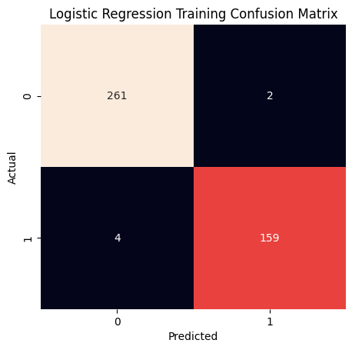
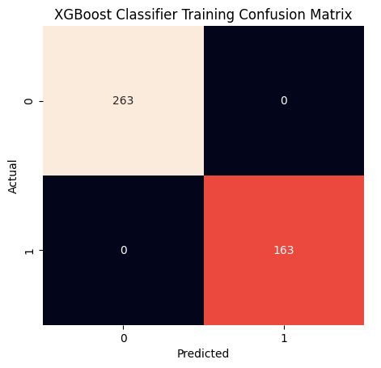
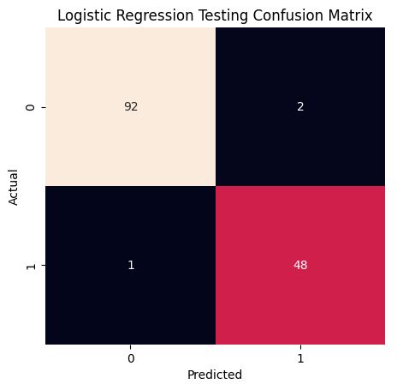
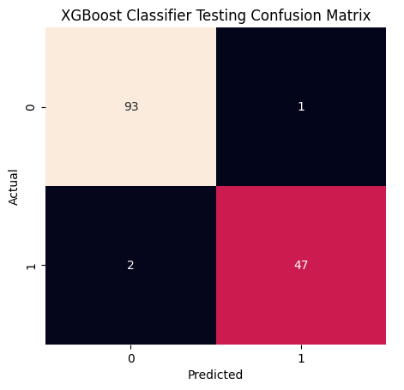
BC Dataset – Logistic Regression vs. XGBoost Classifier

Slide 7
BC Dataset – Classification Reports
Logistic Regression Model Training Classification Report
--------------------------------------------------------
precision recall f1-score support
0 0.98 0.99 0.99 263
1 0.99 0.98 0.98 163
accuracy 0.99 426
macro avg 0.99 0.98 0.99 426
weighted avg 0.99 0.99 0.99 426
________________________________________________________
Logistic Regression Model Testing Classification Report
--------------------------------------------------------
precision recall f1-score support
0 0.99 0.98 0.98 94
1 0.96 0.98 0.97 49
accuracy 0.98 143
macro avg 0.97 0.98 0.98 143
weighted avg 0.98 0.98 0.98 143
XGB Classifier Model Training Classification Report
--------------------------------------------------------
precision recall f1-score support
0 1.00 1.00 1.00 263
1 1.00 1.00 1.00 163
accuracy 1.00 426
macro avg 1.00 1.00 1.00 426
weighted avg 1.00 1.00 1.00 426
________________________________________________________
XGB Classifier Model Testing Classification Report
--------------------------------------------------------
precision recall f1-score support
0 0.98 0.99 0.98 94
1 0.98 0.96 0.97 49
accuracy 0.98 143
macro avg 0.98 0.97 0.98 143
weighted avg 0.98 0.98 0.98 143

Slide 8
BC Dataset
Neural Network
Setup
Results
Layers
Evaluation
nn.add(Dense(units=16, input_dim=31, activation="relu"))
nn.add(Dense(units=8, activation="relu"))
nn.add(Dense(units=1, activation="sigmoid"))
loss: 0.1247
categorical_accuracy: 0.9650
Predictions
Compilation
Benign (0.0) - 88
malignant (1.0) - 55
nn.compile(loss="binary_crossentropy", optimizer="adam", metrics=["accuracy"])
Fitting the model
nn.fit(X_train_scaled, y_train, epochs=200)

Slide 9
BRCA Dataset
Neural Network
Setup
Results
Layers
Evaluation
nn.add(Dense(units=7, input_dim=14, activation="relu"))
nn.add(Dense(units=4, activation="relu"))
nn.add(Dense(units=2, activation="relu"))
nn.add(Dense(units=1, activation="relu"))
nn.add(Dense(units=1, activation="relu"))
loss: (NaN)
categorical_accuracy: 0.6429
Predictions
Compilation
Infiltrating Ductal Carcinoma (0.0) - 54
Mucinous Carcinoma (1.0) - 4
Infiltrating Lobular Carcinoma (2.0) - 20
No Prediction (NaN) - 6
nn.compile(loss="binary_crossentropy", optimizer="adam", metrics=["accuracy"])
Fitting the model
nn.fit(X_train_scaled, y_train, epochs=50)

Slide 10
BRCA Dataset Sequential Neural Network
Setup
Results
Layers
Evaluation
(Dense(25, input_dim = number_of_predictors, activation = 'relu'))
(Dense(25, activation = 'relu'))
(Dense(25, activation = 'tanh'))
(Dense(25, activation = 'tanh'))
(Dropout(.1))
(Dense(number_of_classes, activation='softmax’))
loss: 0.1370
categorical_accuracy: 0.6875
Predictions
Infiltrating Ductal Carcinoma - 80
Compilation
(loss="categorical_focal_crossentropy", optimizer= "adam", metrics=['categorical_accuracy’])
Fitting the model
number_of_epochs = 200
nn.fit(X_train_scaled, y_train, epochs = number_of_epochs, shuffle = True)

Slide 11
Group Approach to Achieve Project Goals
Evaluation Methods
.evaluate (Neural Networks)
confusion matrix, classification report(Logistic Regression/XGB Classifier)
Unanticipated Problems
NaNs in y_test (Neural Network BRCA)
Notes:
The approach that your group took to achieve the project goals. (5 points)
Include any relevant code or demonstrations of the machine learning model.
Describe the techniques that you used to evaluate the performance of the model.
Discuss any unanticipated insights or problems that arose and how you resolved them.

Slide 12
Results / Conclusions
Almost perfectly predict if somebody had cancer.
BC Dataset
96.5% Accurate (Neural Network)
99% training, 98% testing Accuracy (LR Model)
100% training, 98% testing Accuracy (XGB Classifier Model)
Not able to predict the type of cancer based on the provided data with enough accuracy.
BRCA Dataset
68.75% Accurate (Sequential Neural Network)
64.29% Accurate (Neural Network)
Notes:
The results and conclusions from the machine learning model or application. (5 points)
Include relevant images or examples to support your work.
If the project goal wasn’t achieved, share the issues and what the group tried for resolving them.

Slide 13
Next Steps
BC Dataset
Find more testing data
BRCA Dataset
Deeper analysis of BRCA model, where it fails.
Try to determine which features are necessary to predict cancer type
Notes:
Next steps. (2 points)
Discuss the potential next steps for the project.
Discuss any additional questions that you’d explore if you had more time. Specifically, if you had additional weeks to work on your project, what would you research next?

